Slide 1
PMIC T-Autogen Introduction
Jeff Li

Slide 2
General Flow
New Kick Off
Hardware
TestPlan
SCGH
PatList csv
VBT gen tool
OTP file
File Naming Convention :
Test plan: [ProjectName]_*_TestPlan_*.xlsx
SCGH: [ProjectName]_*_scgh_*.xlsx
Pattern List: [ProjectName]_*_Patterns_List_Ext_*.csv
VBT gen tool : *VBT_Gen_Tool_*.xlsm
OTP file : *.otp or *.yaml
-Using PA file to generate
1) Channel Map
2) Pin Map
T-Autogen
Test program
Error Report

Slide 3
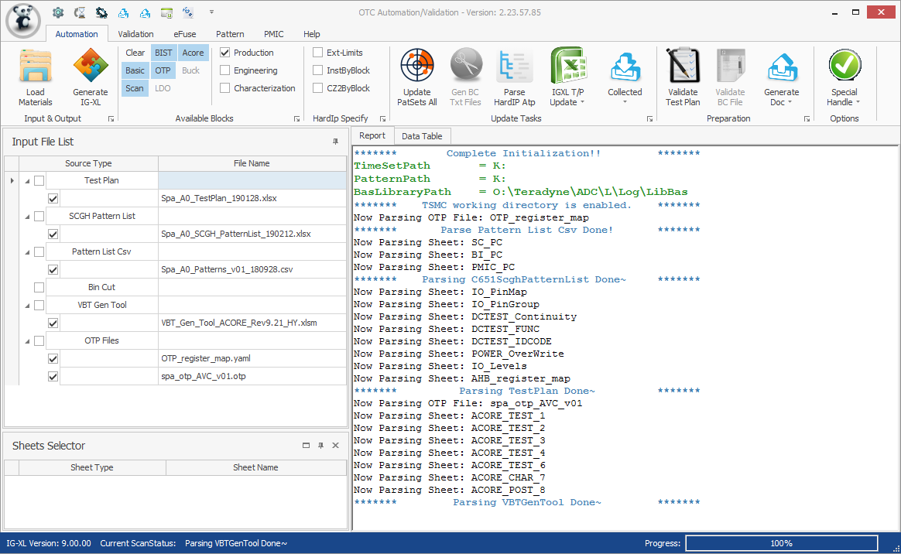
Input File
Click “Load Materials” button, and select PMIC input file
Test Plan => For all blocks
SCGH Pattern List => For Scan, Mbist, OTP
Pattern List Csv => For pattern, TimeSet
VBT Gen Tool => For LDO, Acore, Buck
Otp File (*.yaml / *.otp) => For OTP

Slide 4
Test Plan Sheet Summary
Category | Item No. | Naming Convention | Description | Must/ Optional
Continuity | 1 | DCTEST_Continuity | Define DC test flow and Open/Short Limit | ●
Pin Map & Group | 1 | IO_Pinmap | To generate Pinmap | ●
 | 2 | ChannelMap | To generate Channel map | ●
 | 3 | IO_PinGroup | Define all I/O & Power pin groups used in Test Plan | ○
Power | 1 | VDD_Levels | To generate DC spec/Level sheet | ●
 | 2 | IO_Levels |  | ●
IDS | 1 | PMIC_IDS | Define IDS test, the format is the same as HARDIP | ●
Leakage | 1 | PMIC_Leakage | Define Leakage test, the format is the same as HARDIP | ●
DCTest | 1 | DCTEST_XXXX | Define DC function test, the format is the same as HARDIP | ●
Flow (2 choose 1) | 1 | GenMainFlow | Define Main flow by user definition | ○
 | 2 | Flow_Main | Define Main flow for all Test stage | ○
OTP | 1 | AHB_register_map | To generate AHB_register_map for OTP | ●

Slide 5
SCGH Sheet Summary
Category | Item No. | Naming Convention | Description | Must/Optional
SCAN | 1 | SC_PC | To generate Flow/Instance for SCAN | ●
BIST | 2 | BI_PC | To generate Flow/Instance for MBIST | ●
DCTEST_XXXX | 3 | PMIC_PC | To define pattern used in DCTEST | ●

Slide 6
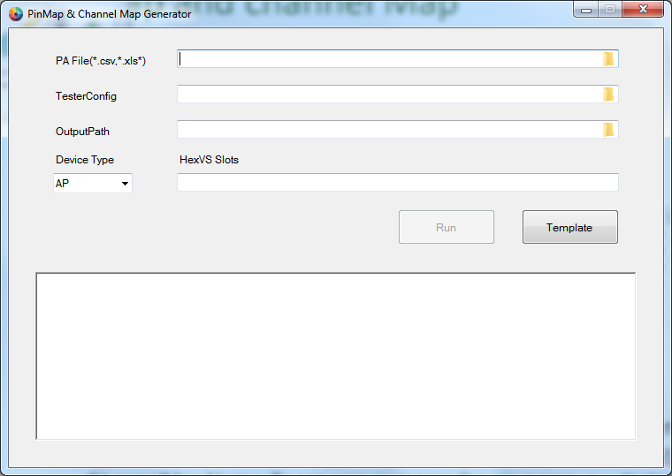
Pin Map and channel Map
GUI of PinMap tool

Slide 7
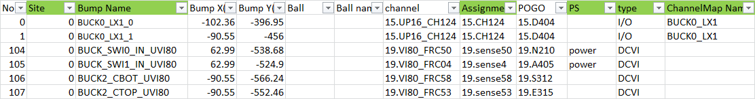
Pin Map and channel Map
Format of PA
Site : To define site for multi site test.
Bump Name : This is pin name in pin map and channel map.
Assignment : To define the channel of pin in channel map.
PS : User can specify this pin is power pin by using syntax “power”.
Type : To define the type of pin in channel map. (ex. I/O,DCVI,GND,Utility)
ChannelMap Name: To rename or merge the pin name. (ex. BUCK0_LX1_0 & BUCK0_LX1_1 use the same channel and merge into BUCK0_LX1) If channelMap Name is empty, tool will use Bump Name as pin name.

Slide 8
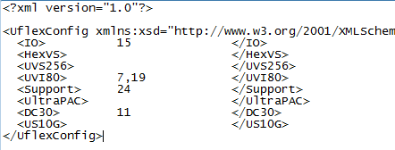
Pin Map and channel Map
Format of Tester config
Tester config is used to define the slot of instrument
To generate Pin Group
Base on the instrument type in tester config tool will generate All_[instrument type]. (ex. All_IO,All_UVI80)
To generate DCVI pin group (ex. DCVI for power pin group and DCVI_Analog for Analog pin group)

Slide 9
Pin Map and channel Map
Same channel pins
Tool will modify the channel name (ex. S:IDAC_OUT_0_DC30) when the channel are the same.
Rule for PMIC only
If the channel type is “DCVI”, tool will generate the secondary pin for DCDiffMeter & DCTime with the same channel as below.

Slide 10
Global Specs
T-Autogen will use “VDD_Levels” sheet in test plan to generate global Specs, including LV/NV/HV/HV2 and power sequence for power up.
Other Specified Global Specs
SCAN_Speed : 16000000 (hardcode)
SCAN_Period : =1/_SCAN_Speed
Mbist_Speed : 16000000 (hardcode)
Mbist_Period : =1/_Mbist_Speed
VDD_Levels sheet

Slide 11
DC Specs / Level Sheet
T-Autogen will use “VDD_Levels” sheet in test plan to generate DC Specs/Level Sheet.
Default categories : Common, IDS, Conti, Leakage, nWire, Scan, BScan, Mbist, Analog DC Categories.
If user want to modify original DC spec or to create new DC spec, user can use “POWER_OverWrite” to generate DC Spec/Level Sheet.
POWER_OverWrite
DC spec
formula base
Fixed
Power_overwrite will change from formula to fixed value.

Slide 12
DC Specs / Level Sheet
“IO_Levels” sheet will
Add level rows for IO pins.
Generate Pin group by Domain column (ex. VDDIO)
IO_Levels
Level sheet Name
Valid headers are Domain,VDD,VIH,VIL,VOH,VOL .
Level sheet
Pin Group

Slide 13
Backup

Slide 14
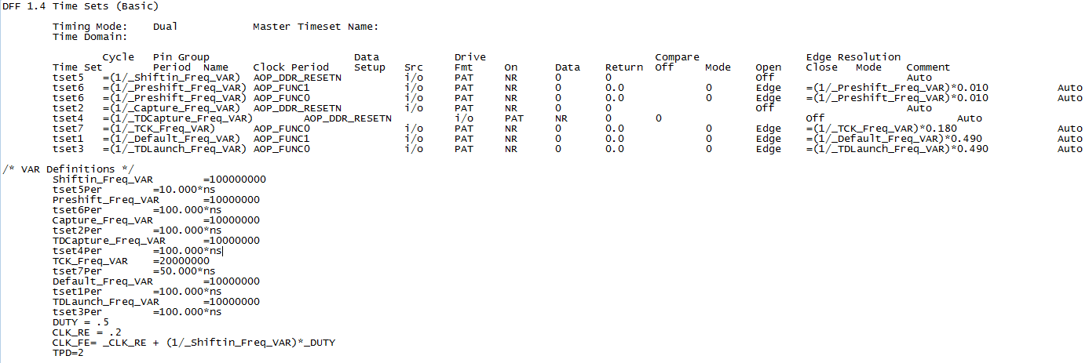
AC Specs
AC category generation rule :
Free Running Clock variable : T-Autogen will generate by “FreeRunningClock” in Settings\Basic\nWire_and_relay_[ProjectName].xlsx
TimeSet variable : T-Autogen will follow SOC rule to add customized variable into AC spec by TimeSet.
Generated AC Category | Assigned Block | TimeSet Name
Common | Remaining other blocks | TIMESET_*_*_JT_*_*
BScan | DCTest | TIMESET_*_*_IO_*_*
Scan | Scan | TIMESET_*_*_SC_*_*
Mbist | Mbist | TIMESET_*_*_BI_*_*
Follow SOC rule.
Skip at least 1 line after the last tset line
Use header : /* Var Definitions */ to denote start of variable declaration portion.

Slide 15
Scan and Mbist
Needed sheets in SCGH:
SC_PC : scan prod char sheet
BI_PC : Mbist prod char sheet
Flow/Instance Generation:
Flow
Instance
Input File : SCGH: SC_PC /BI_PC

Slide 16
LDO/Acore Work Flow
Autogen Tool
VBT gen tool
Read input file
VBT gen tool/test Plan
Trigger macro to generate VBT
Gen. SubFlow sheet
Gen. Instance sheet
Gen. Bintable
sheet
Gen. LDO/Acore VBT
Merge & Gen. IGXL

Slide 17
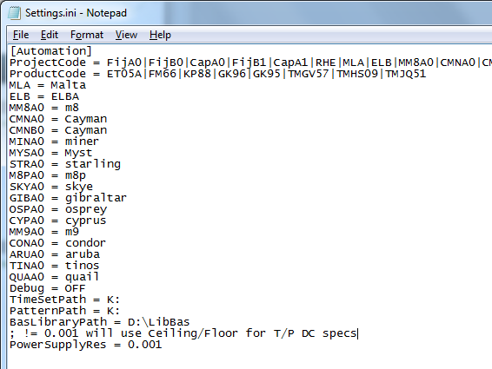

LDO T-Autogen
Input file : VBT generate tool & Test plan
(FileName format : *VBT_Gen_Tool_*.xlsm)
LIB path : To get relative test info. for VBT gen tool to generate VBT.
(Default path : BasLibraryPath in Setting.ini & \PMIC\LIB)
VBT Output path : To place created VBT modules to generate new test program. (Default path : User’s specified output path & \IGLink\trunk\Module\LibraryConding)
Customized VBT : To copy all *.bas/*.cls in VBT_Gen_Tool into new test program.
=> Copy modules/Classes from VBT_Gen_Tool
=> LIB path is D:\LibBas\PMIC\LIB

Slide 18
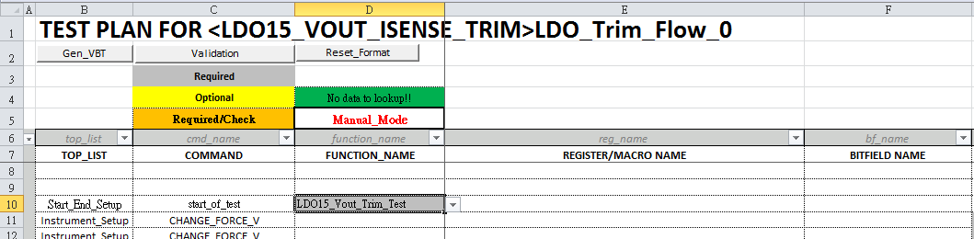
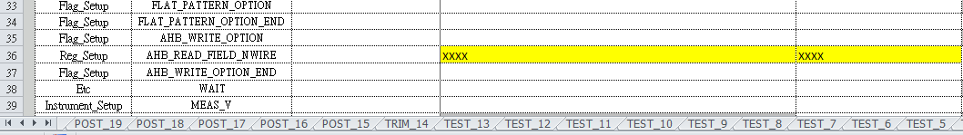
VBT generate tool
Sheet Name :
B1 cell starts with “TEST PLAN FOR <“ & sheet name ends with “_ sequence number” can be identified as test plan sheet, and flow will order by this sheet sequence.
SubFlow Name :
First key word of flow name will be used as block name. (eg. Only block name “LDO” can be generated by LDO block.)
T-Autogen will used the full flow name to generate sub flows.(eg. Flow_LDO_TRIM, Flow_LDO_POSTBURN)
Instance / VBT function Name : T-Autogen will generate instances when command was “start_of_test”.
Full flow name
Instance/ VBT function name
Sheet name

Slide 19
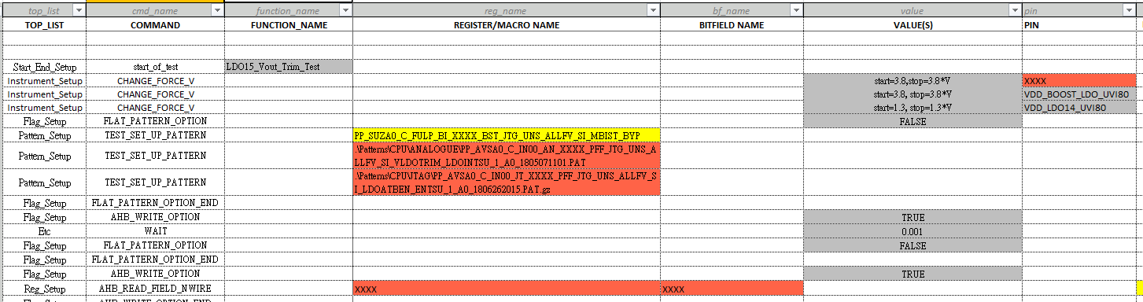
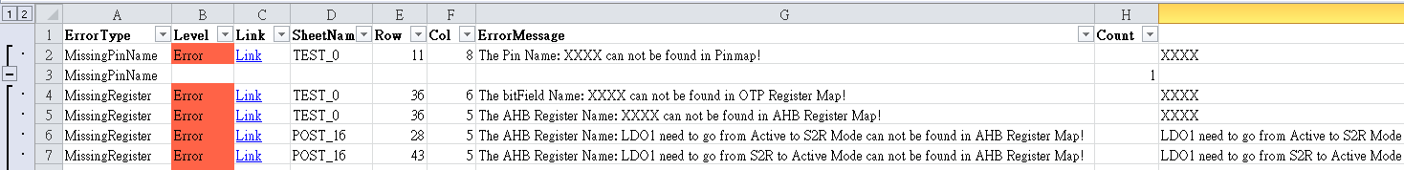
Syntax Check
Pin Name : Check if the pin name can be found in pinmap.
Pattern Name: Check if the generic pattern name, that’s command is “TEST_SET_UP_PATTERN”, can checked if it can be found in pattern list Csv.
Bit Field Name : Check if the bit field name can be found in AHB Register Map.
AHB Register Name : Check if the AHB register name, that’s command started with “AHB_WRITE” or “AHB_READ”, can be found in AHB Register Map.
pattern name
Pin name
AHB register name
Bit field name
Error Report

Slide 20
Test number in subflow
T autogen will base on the table in “Block_TestNumber” sheet of \Settings\Basic\TN_Assignment_[project].xlsx to generate Test number in subflow.
User can define test number in the each subflow sheet by start, end and step column.

Slide 21
Bin number
T autogen will base on the table in DC_HardIp_Bin_Def sheet of BinNumberConfig_PMIC.xlsx to generate Bin number.

Slide 22
OTP
Input file : OTP files(*.otp/*.yaml)
Output file:
Use OTP files to generate “OTP_default_reglist” & “OTP_register_map” & ”GlobalAddressMap”, that will be loaded by OTP VBT.
Use “PMIC_PC” in SCHG file to generate to patSet.
Merge the standard subflow and instance sheet into test program.
(\Settings\eFuse\Efuse_Flow_TestInst_[ProjectName].xlsx)
OTP_default_reglist
GlobalAddressMap
OTP_register_map

Slide 23
Free Running Clock
T-Autogen will use “FreeRunningClock” table to generate free Running Clock variable into AC specs and TimeSet.
Settings\Basic\nWire_and_relay_[ProjectName].xlsx

